Slide 1
Renew Library
Zachary Cox

Slide 2
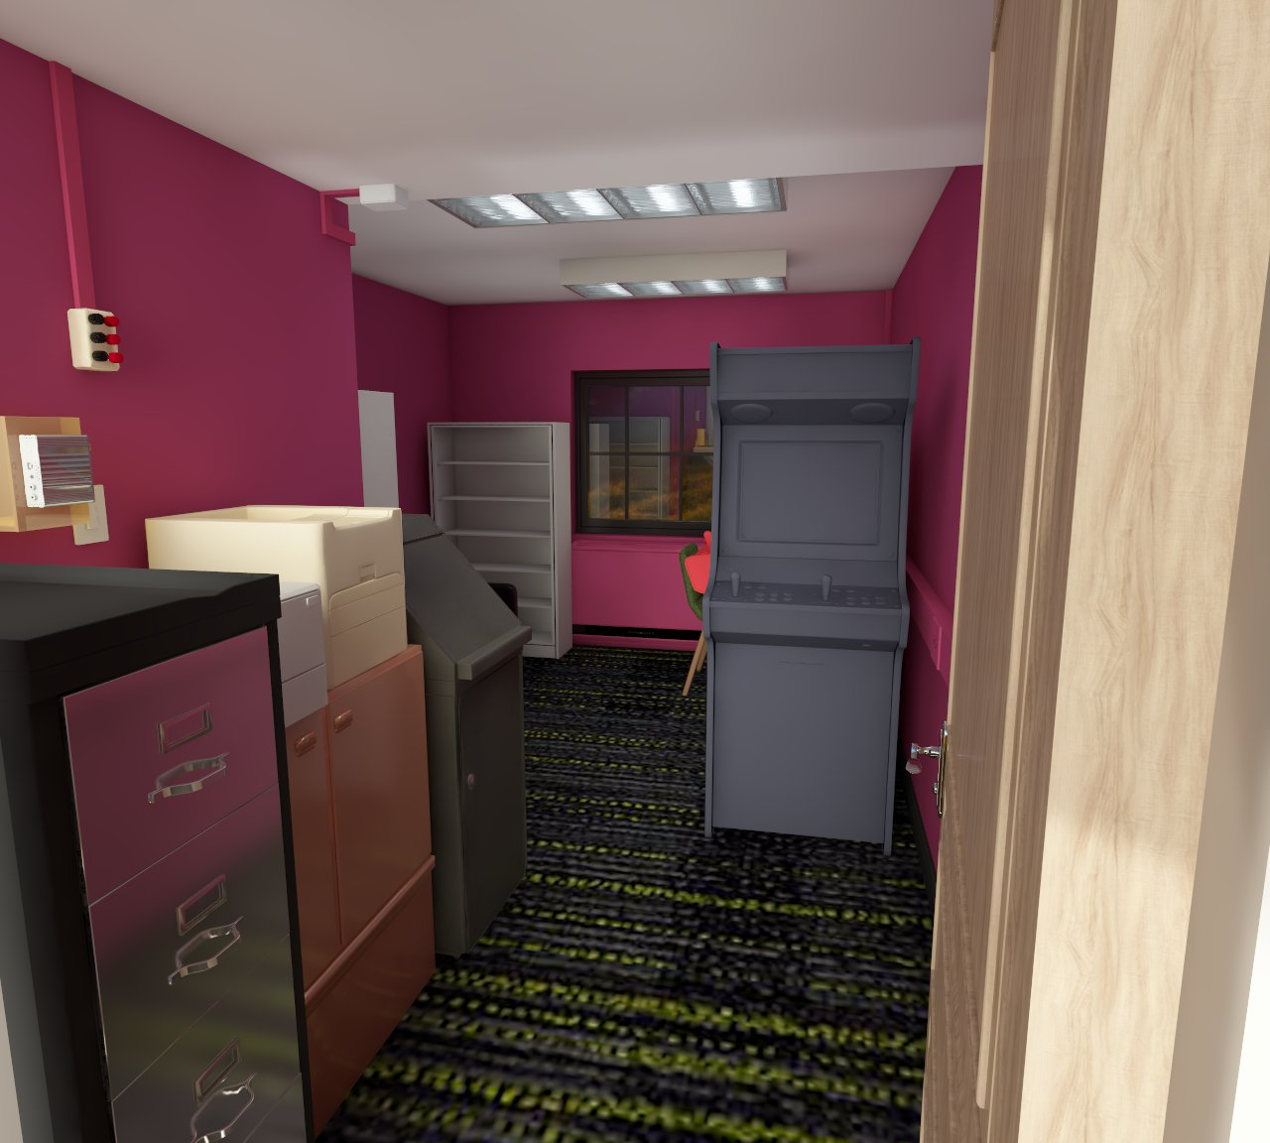
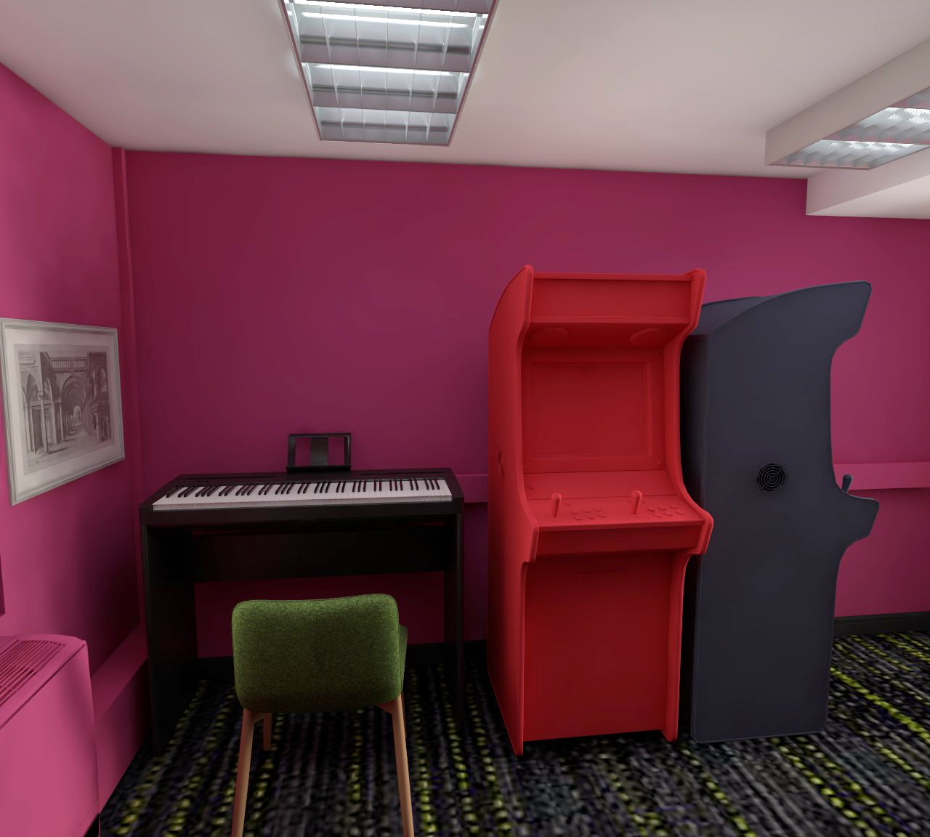
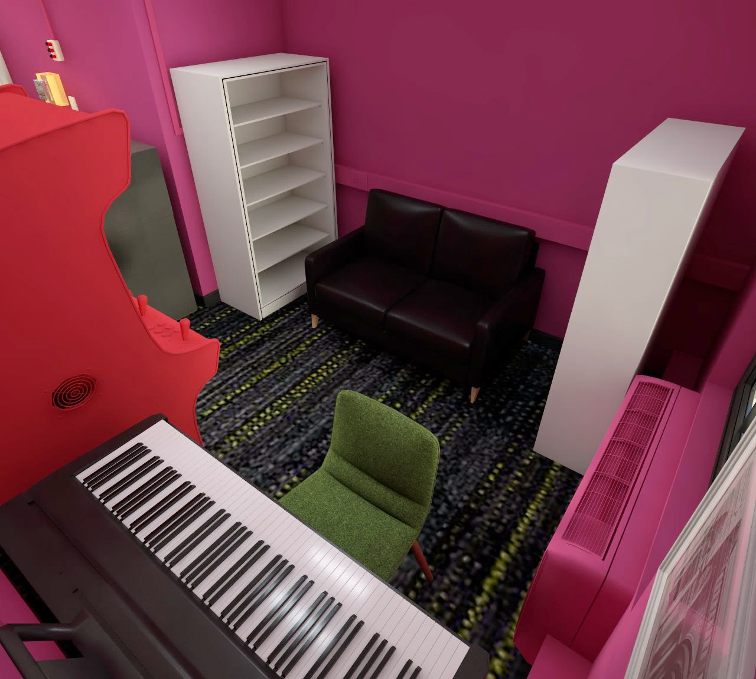
The Current Layout
Current Problems
The printer station is far from the outlet so there are long power strips running form the outlet on the couch wall and it’s a mess back there.
If someone is printing something out, they are blocking the entryway.
Very large lack of storage and display areas
Drink Admin doesn’t work and takes up a lot of space
The shelf on the left side of the couch is kinda crappy

Slide 3
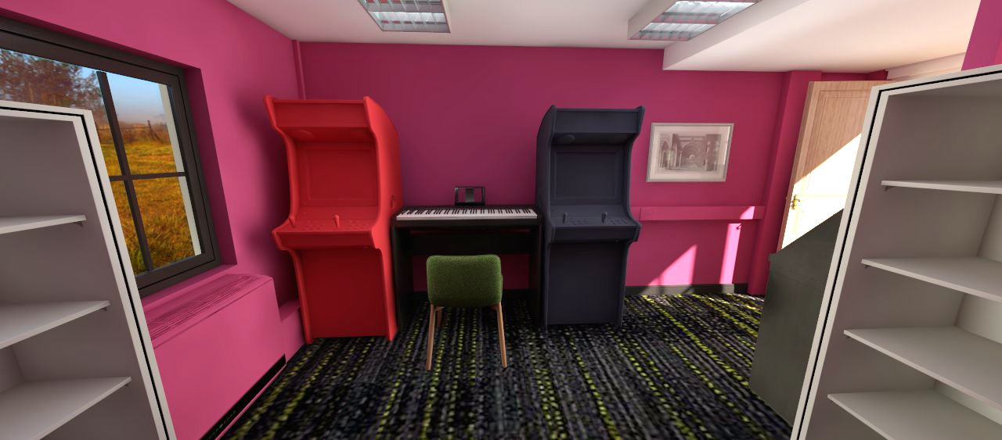
Layout #1
Pros:
Easiest thing to do (would take very little to actually do)
Makes it look a little better.
Cons:
Doesn’t really do much in terms of maximizing space and doesn’t really solve any problems

Slide 4
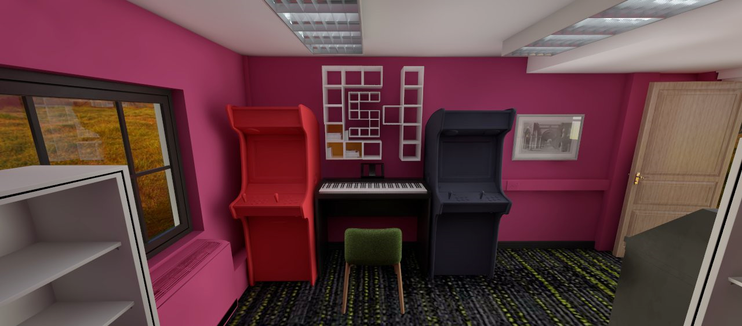
Layout #2
Pros:
Builds upon the last layout and adds cool custom CSH shelving! We could even possibly add lights to it and make it look even cooler!
Cons:
Making the custom shelves might be somewhat difficult.
We’d also have to probably get housing to approve this since they’d be mounted to the wall.

Slide 5
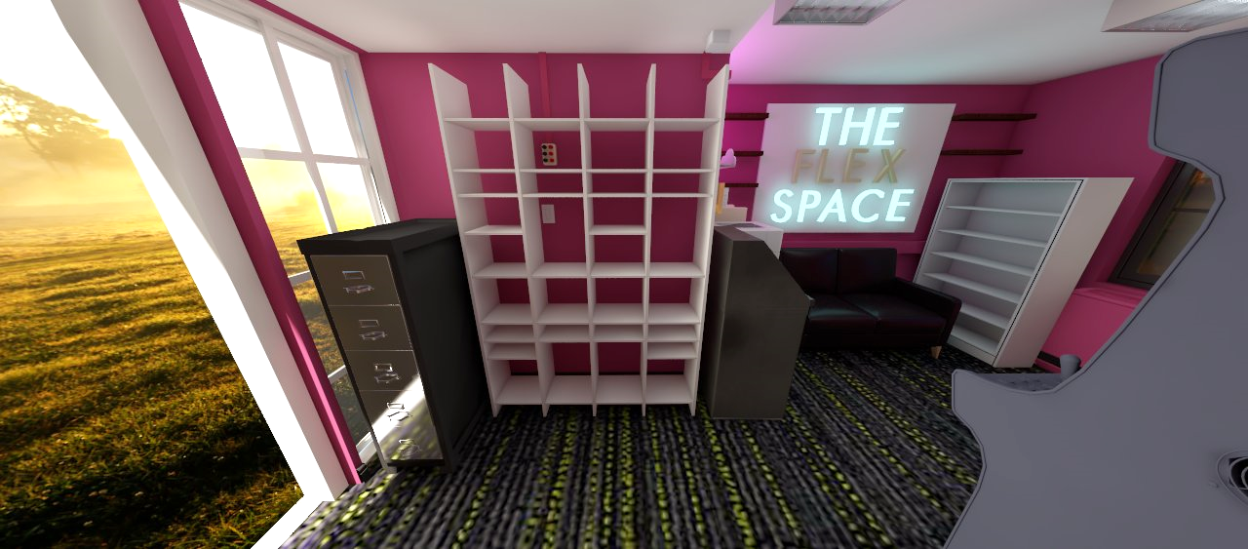
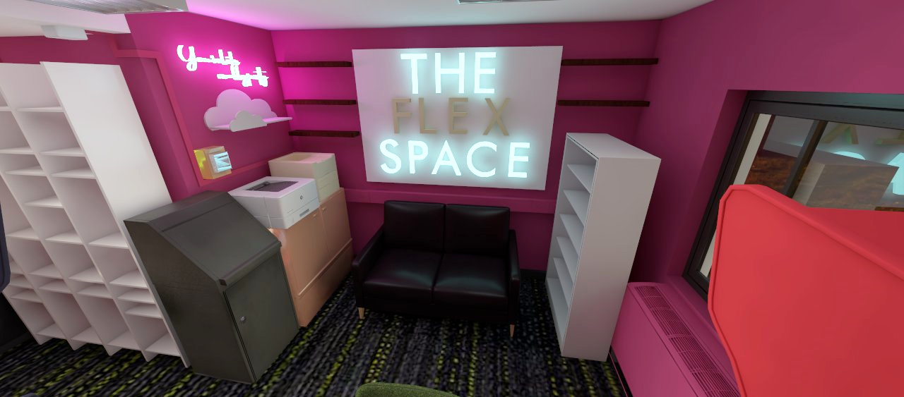
Layout #3
Pros:
Moves all the electrical equipment closer to the outlet
Moves the printers out of the walkway and you can print while sitting on the couch!
More shelves!!
Replaces the crappy metal shelf that’s currently by the couch
Possibly add cute little signs
Cons:
Would take a lot of work to make happen
A new cool shelf unit might cost some money
Like the previous one, would have to get approval to add wall shelves
*** “The Flex Space” is an area that is dedicated to different pictures or articles that we can swap out for different events like tours etc ***

Slide 6
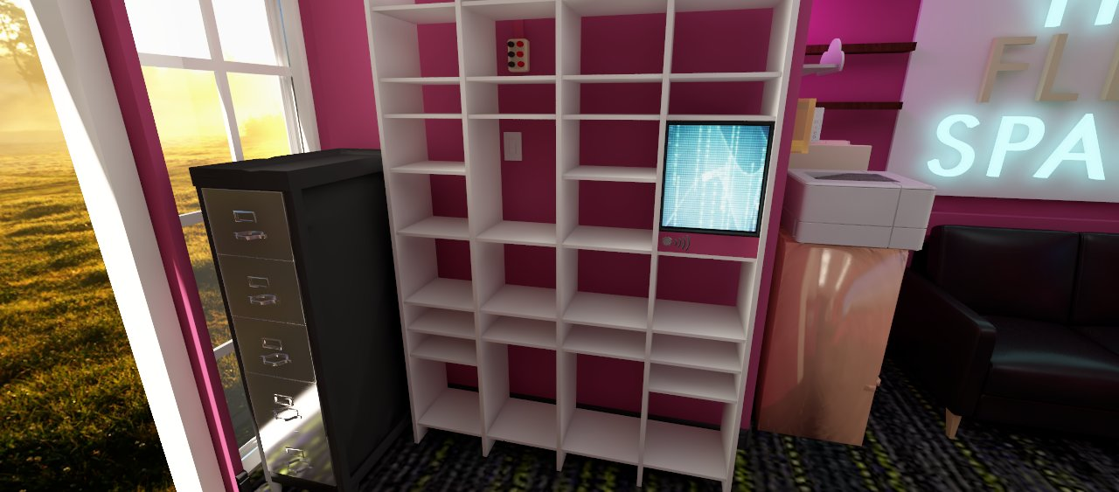
Layout #4
Pros:
Gets rid of the current clunky drink admin
Cons:
Someone would have to figure out how to make the new one and get it to work

Slide 7
More to come!™

